Slide 1

W4111 – 02: Introduction to Databases
Lecture 3: ER Modeling, SQL, Relational (Part 2)
Donald F. Ferguson dff9@Columbia.edu
TRANSCENDING DISCIPLINES, TRANSFORMING LIVES

Slide 2
I will be back in a minute. Send Slack message or chat in Zoom meeting.

Slide 3

Introduction to the Relational Model
3 | W4111_02_F20: Introduction to Databases -- Lecture 2

Slide 4

Relational Model/Algebra Overview
4 | W4111_02_F20: Introduction to Databases -- Lecture 3

Slide 5
Chapter 2: Intro to Relational Model

Slide 6
Outline
Structure of Relational Databases
Database Schema
Keys
Schema Diagrams
Relational Query Languages
The Relational Algebra
Introduction to concepts in this lecture.
We will progressively cover in more detail.
Notes:
1

Slide 7
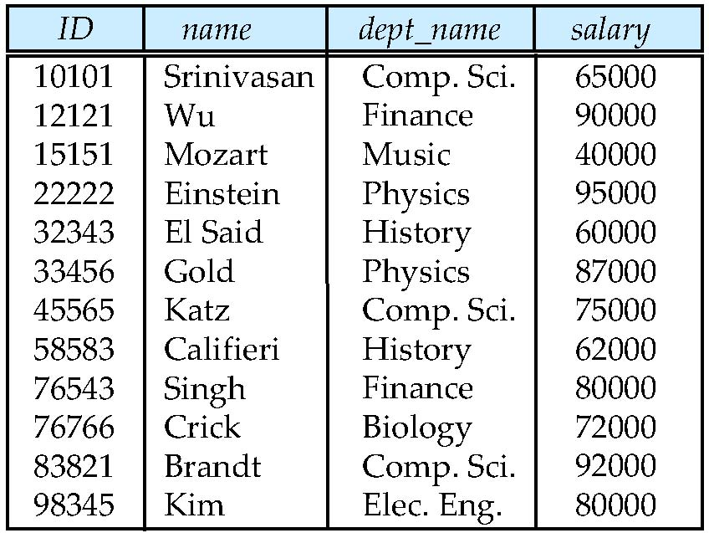
Example of a Instructor Relation
attributes
(or columns)
tuples
(or rows)
The ER Model talks about
Entity
Entity Sets
In the Relational Model the concepts are:
Tuple (row)
Relation
In SQL:
Table
Row

Slide 8
Attribute
The set of allowed values for each attribute is called the domain of the attribute
Attribute values are (normally) required to be atomic; that is, indivisible
The special value null is a member of every domain. Indicated that the value is “unknown”
The null value causes complications in the definition of many operations
Codd’s Rules (https://www.tutorialspoint.com/dbms/dbms_codds_rules.htm)
Rule 3: Systematic Treatment of NULL Values
The NULL values in a database must be given a systematic and uniform treatment. This is a very important rule because a NULL can be interpreted as one the following − data is missing, data is not known, or data is not applicable.
YOU CANNOT REPRESENT VALUE UNKNOWN, NOT APPLICABLE, ETC. USING “”, -1, OR SOME OTHER INVALID VALUE.

Slide 9
Attribute
The set of allowed values for each attribute is called the domain of the attribute
Attribute values are (normally) required to be atomic; that is, indivisible
The special value null is a member of every domain. Indicated that the value is “unknown”
The null value causes complications in the definition of many operations
A lot of things you think are “atomic” are actually not, e.g.
COMSW4111 is actually
COMS – department code.
W – faculty code.
4 – course type/classification code/level.
111
dff9@columbia.edu is actually:
dff9 – user ID
columbia – organization name (subdomain)
edu – Top level domain.
Names
“Ferguson,Donald”
(lastname, firstname)
This concept and related concepts have surprising implications on “data integrity.”
No Columbia course begins with “7”
columbia.mil and columbia.gov are not OK because Columbia is not yet a military organization or government.
We will also see that there are performance implications.

Slide 10
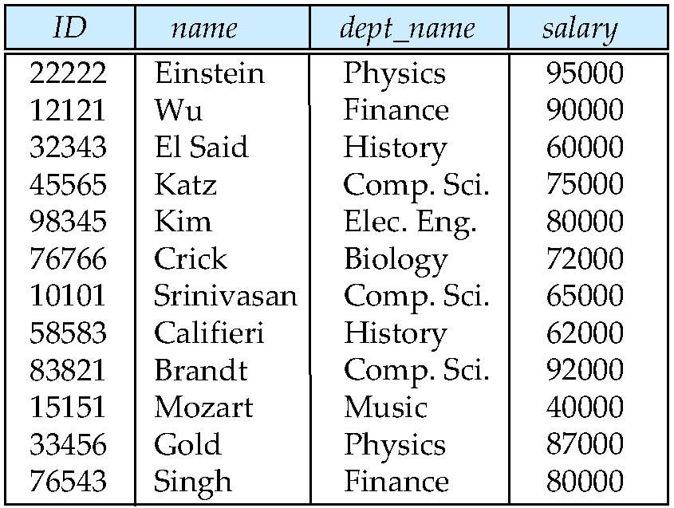
Relations are Unordered
Order of tuples is irrelevant (tuples may be stored in an arbitrary order)
Example: instructor relation with unordered tuples
Relations are/may be ordered in SQL.
Relations are sets in the theory but not necessarily in SQL.
We will cover.

Slide 11
Database Schema
Database schema -- is the logical structure of the database.
Database instance -- is a snapshot of the data in the database at a given instant in time.
Example:
schema: instructor (ID, name, dept_name, salary)
Instance:

Slide 12
Keys (Covered in 19-Sep Recitation)
Let K ⊆ R R(lastname, firstname, iq, ssno) K(iq, ssno)
K is a superkey of R if values for K are sufficient to identify a unique tuple of each possible relation r(R)
Example: {ID} and {ID,name} are both superkeys of instructor.
Superkey K is a candidate key if K is minimal Example: {ID} is a candidate key for Instructor
One of the candidate keys is selected to be the primary key.
which one?
Foreign key constraint: Value in one relation must appear in another
Referencing relation
Referenced relation
Example: dept_name in instructor is a foreign key from instructor referencing department

Slide 13
Keys
Keys, especial foreign keys, is a baffling topic in the beginning. Do not worry if you are confused. You will grasp the concept.
SQL (MySQL) worsens the confusion because DB engines:
Implement keys using indexes, which intertwines two concepts and terminology.
Have additional types of keys and constraints.
There are several good online tutorials:
Examples:
https://www.guru99.com/dbms-keys.html
https://www.tutorialspoint.com/Various-Types-of-Keys-in-DBMS
Many, many others.
These sometimes
Help (through examples)
and sometimes increase confusion because there are no standards for some terminology, and they use inconsistent terms.
The only way to learn is by doing. My approach is:
Do not lecture on topics that you can easily read. This is not an audio book.
Learn by doing with worked examples in class, recitation, etc.
13 | W4111_02_F20: Introduction to Databases -- Lecture 3

Slide 14
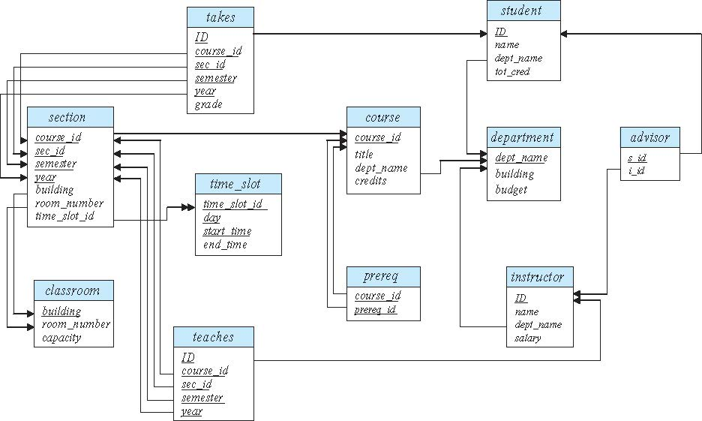
Schema Diagram for University Database
This is not a great schema design.
We will work on defining better schema for this domain in worked exercises in class and lectures.
Unfortunately, to explain “keys,” I often have to also use bad designs.

Slide 15
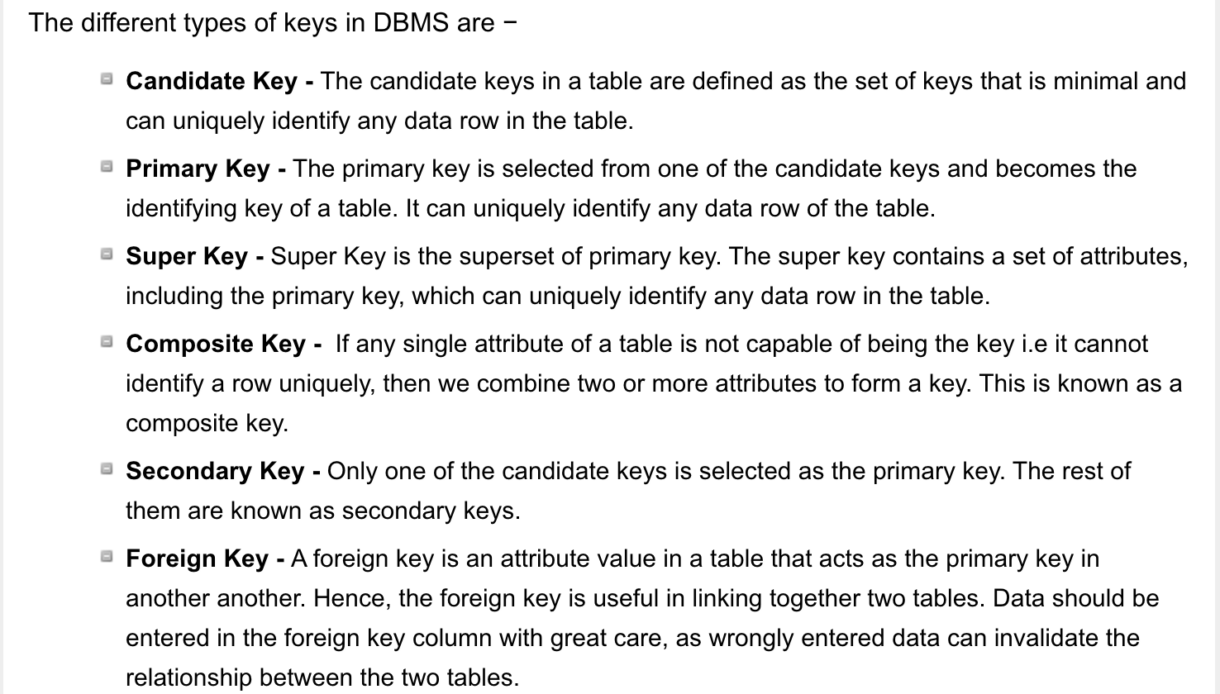
One Terminology (https://www.tutorialspoint.com/Various-Types-of-Keys-in-DBMS)
15 | W4111_02_F20: Introduction to Databases -- Lecture 3

Slide 16
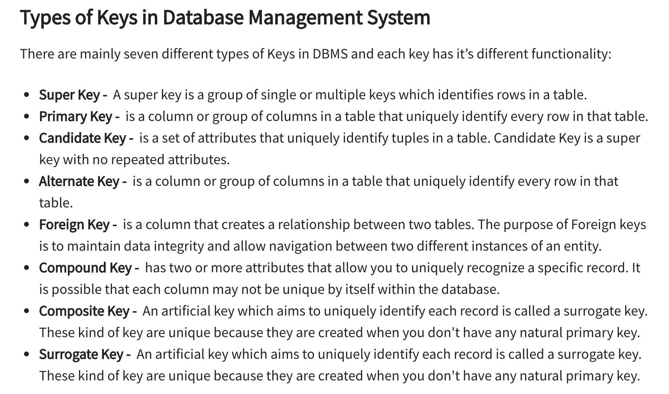
A Second Terminology (https://www.guru99.com/dbms-keys.html)
???
16 | W4111_02_F20: Introduction to Databases -- Lecture 3

Slide 17
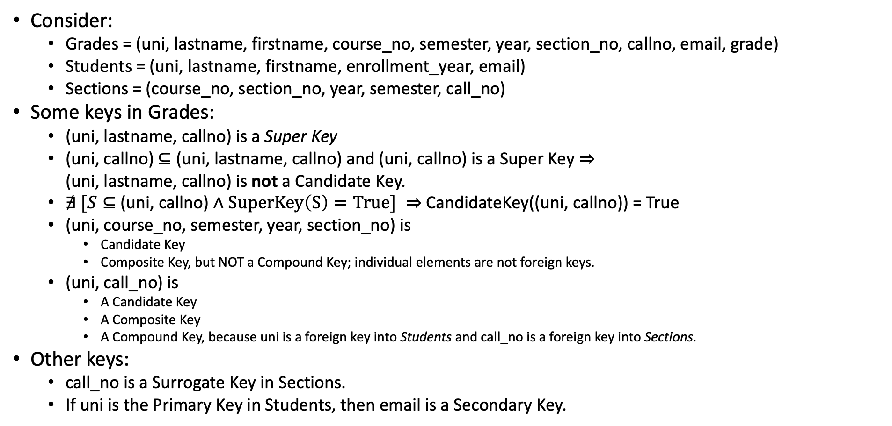
An Example
Consider:
Grades = (uni, lastname, firstname, course_no, semester, year, section_no, callno, email, grade)
Students = (uni, lastname, firstname, enrollment_year, email)
Sections = (course_no, section_no, year, semester, call_no)
Some keys in Grades:
(uni, lastname, callno) is a Super Key
(uni, callno) $⊆$ (uni, lastname, callno) and (uni, callno) is a Super Key $⇒$ (uni, lastname, callno) is not a Candidate Key.
$∄ [S⊆$ (uni, callno) $∧SuperKey\left(S\right)=True] ⇒$ CandidateKey((uni, callno)) = True
(uni, course_no, semester, year, section_no) is
Candidate Key
Composite Key, but NOT a Compound Key; individual elements are not foreign keys.
(uni, call_no) is
A Candidate Key
A Composite Key
A Compound Key, because uni is a foreign key into Students and call_no is a foreign key into Sections.
Other keys:
call_no is a Surrogate Key in Sections.
If uni is the Primary Key in Students, then email is a Secondary Key.
17 | W4111_02_F20: Introduction to Databases -- Lecture 3

Slide 18
Person(uni, lastname, middlename, firstname, email, role)
(xxxx, Ferguson, Donald, Francis, Professor)

Slide 19
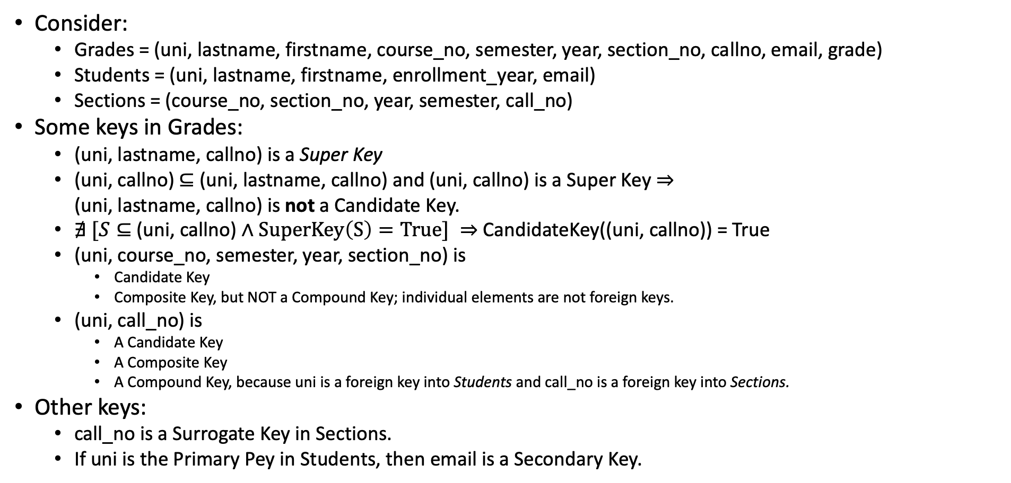
An Example
Comments:
If I got that right, it was a miracle.
If you understood that, it was a miracle.
Do not worry if I got that right and you did not understand.
If I got it wrong, and you did understand, that is bad.
“There is no concept so simple that database professors cannot make it confusing, often using math.”
We will cover the concepts and theory, but I tend to focus on practical scenarios.
Why do I cover the theory?
Interesting and important, and sometimes useful.
People cannot yell at me for not teaching the theory.
Consider:
Grades = (uni, lastname, firstname, course_no, semester, year, section_no, callno, email, grade)
Students = (uni, lastname, firstname, enrollment_year, email)
Sections = (course_no, section_no, year, semester, call_no)
Some keys in Grades:
(uni, lastname, callno) is a Super Key
(uni, callno) $⊆$ (uni, lastname, callno) and (uni, callno) is a Super Key $⇒$ (uni, lastname, callno) is not a Candidate Key.
$∄ [S⊆$ (uni, callno) $∧SuperKey\left(S\right)=True] ⇒$ CandidateKey((uni, callno)) = True
(uni, course_no, semester, year, section_no) is
Candidate Key
Composite Key, but NOT a Compound Key; individual elements are not foreign keys.
(uni, call_no) is
A Candidate Key
A Composite Key
A Compound Key, because uni is a foreign key into Students and call_no is a foreign key into Sections.
Other keys:
call_no is a Surrogate Key in Sections.
If uni is the Primary Pey in Students, then email is a Secondary Key.
19 | W4111_02_F20: Introduction to Databases -- Lecture 3

Slide 20
Relational Query Languages
Procedural versus non-procedural, or declarative
“Pure” languages:
Relational algebra
Tuple relational calculus
Domain relational calculus
The above 3 pure languages are equivalent in computing power
We will concentrate in this chapter on relational algebra
Not turing-machine equivalent
Consists of 6 basic operations

Slide 21
Relational Algebra
A procedural language consisting of a set of operations that take one or two relations as input and produce a new relation as their result.
Six basic operators
select: σ
project: ∏
union: ∪
set difference: –
Cartesian product: x
rename: ρ

Slide 22
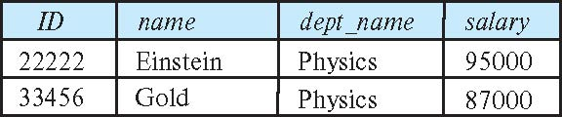
Select Operation
The select operation selects tuples that satisfy a given predicate.
Notation: σ _{p} (r)
p is called the selection predicate
Example: select those tuples of the instructor relation where the instructor is in the “Physics” department.
Query
σ _{dept_name=“Physics”} (instructor)
Result

Slide 23
Select Operation (Cont.)
We allow comparisons using
=, ≠, >, ≥. <. ≤
in the selection predicate.
We can combine several predicates into a larger predicate by using the connectives:
∧ (and), ∨ (or), ¬ (not)
Example: Find the instructors in Physics with a salary greater $90,000, we write:
σ _{dept_name=“Physics”} ∧ _{salary} > 90,000 (instructor)
Then select predicate may include comparisons between two attributes.
Example, find all departments whose name is the same as their building name:
σ _{dept_name=building} (department)

Slide 24
Project Operation
A unary operation that returns its argument relation, with certain attributes left out.
Notation:
∏ _{A1,A2,A3 ….Ak} (r)
where A₁, A₂ are attribute names and r is a relation name.
The result is defined as the relation of k columns obtained by erasing the columns that are not listed
Duplicate rows removed from result, since relations are sets

Slide 25
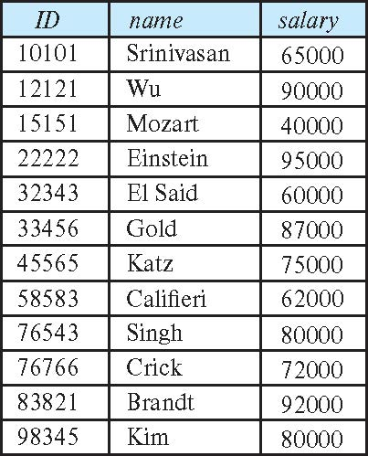
Project Operation (Cont.)
Example: eliminate the dept_name attribute of instructor
Query: ∏_{ID, name, salary} (instructor)
Result:

Slide 26
Composition of Relational Operations
The result of a relational-algebra operation is relation and therefore of relational-algebra operations can be composed together into a relational-algebra expression.
Consider the query -- Find the names of all instructors in the Physics department.
∏_{name}(σ _{dept_name} _{=“Physics”} (instructor))
Instead of giving the name of a relation as the argument of the projection operation, we give an expression that evaluates to a relation.
Relational is an algebra and closed under the operators.
This is a very, very powerful concept, which we will see in future lectures.

Slide 27
Online Relational Algebra Tool
27 | W4111_02_F20: Introduction to Databases -- Lecture 3

Slide 28
Demos
Online relational tool https://dbis-uibk.github.io/relax/landing
28 | W4111_02_F20: Introduction to Databases – Lecture 2

Slide 29
Introduction to SQL
29 | W4111_02_F20: Introduction to Databases -- Lecture 2

Slide 30
Lecture Material – From Book Slides
30 | W4111_02_F20: Introduction to Databases -- Lecture 3

Slide 31
Chapter 3: Introduction to SQL

Slide 32
History
IBM Sequel language developed as part of System R project at the IBM San Jose Research Laboratory
Renamed Structured Query Language (SQL)
ANSI and ISO standard SQL:
SQL-86
SQL-89
SQL-92
SQL:1999 (language name became Y2K compliant!)
SQL:2003
Commercial systems offer most, if not all, SQL-92 features, plus varying feature sets from later standards and special proprietary features.
Not all examples here may work on your particular system.

Slide 33
SQL Parts
DML -- provides the ability to query information from the database and to insert tuples into, delete tuples from, and modify tuples in the database.
integrity – the DDL includes commands for specifying integrity constraints.
View definition -- The DDL includes commands for defining views.
Transaction control –includes commands for specifying the beginning and ending of transactions.
Embedded SQL and dynamic SQL -- define how SQL statements can be embedded within general-purpose programming languages.
Authorization – includes commands for specifying access rights to relations and views.

Slide 34
Data Definition Language
The SQL data-definition language (DDL) allows the specification of information about relations, including:
The schema for each relation.
The type of values associated with each attribute.
The Integrity constraints
The set of indices to be maintained for each relation.
Security and authorization information for each relation.
The physical storage structure of each relation on disk.

Slide 35
Domain Types in SQL
char(n). Fixed length character string, with user-specified length n.
varchar(n). Variable length character strings, with user-specified maximum length n.
int. Integer (a finite subset of the integers that is machine-dependent).
smallint. Small integer (a machine-dependent subset of the integer domain type).
numeric(p,d). Fixed point number, with user-specified precision of p digits, with d digits to the right of decimal point. (ex., numeric(3,1), allows 44.5 to be stores exactly, but not 444.5 or 0.32)
real, double precision. Floating point and double-precision floating point numbers, with machine-dependent precision.
float(n). Floating point number, with user-specified precision of at least n digits.
More are covered in Chapter 4.

Slide 36
Create Table Construct
An SQL relation is defined using the create table command:
create table r
(A₁ D₁, A₂ D₂, ..., A_{n} D_{n}, (integrity-constraint₁), ..., (integrity-constraint_{k}))
r is the name of the relation
each A_{i} is an attribute name in the schema of relation r
D_{i} is the data type of values in the domain of attribute A_{i}
Example:
create table instructor ( ID char(5), name varchar(20), dept_name varchar(20), salary numeric(8,2))

Slide 37
Integrity Constraints in Create Table
Types of integrity constraints
primary key (A₁, ..., A_{n} )
foreign key (A_{m}, ..., A_{n} ) references r
not null
SQL prevents any update to the database that violates an integrity constraint.
Example:
create table instructor ( ID char(5), name varchar(20) not null, dept_name varchar(20), salary numeric(8,2), primary key (ID), foreign key (dept_name) references department);

Slide 38
And a Few More Relation Definitions
create table student ( ID varchar(5), name varchar(20) not null, dept_name varchar(20), tot_cred numeric(3,0), primary key (ID),
foreign key (dept_name) references department);
create table takes ( ID varchar(5), course_id varchar(8), sec_id varchar(8), semester varchar(6), year numeric(4,0), grade varchar(2),
primary key (ID, course_id, sec_id, semester, year) ,
foreign key (ID) references student, foreign key (course_id, sec_id, semester, year) references section);

Slide 39
And more still
create table course ( course_id varchar(8), title varchar(50), dept_name varchar(20), credits numeric(2,0),
primary key (course_id),
foreign key (dept_name) references department);

Slide 40
Updates to tables
Insert
insert into instructor values ('10211', 'Smith', 'Biology', 66000);
Delete
Remove all tuples from the student relation
delete from student
Drop Table
drop table r
Alter
alter table r add A D
where A is the name of the attribute to be added to relation r and D is the domain of A.
All exiting tuples in the relation are assigned null as the value for the new attribute.
alter table r drop A
where A is the name of an attribute of relation r
Dropping of attributes not supported by many databases.

Slide 41
Basic Query Structure
A typical SQL query has the form: select A₁, A₂, ..., A_{n} from r₁, r₂, ..., r_{m} where P
A_{i} represents an attribute
R_{i} represents a relation
P is a predicate.
The result of an SQL query is a relation.
Notes:
2

Slide 42
The select Clause
The select clause lists the attributes desired in the result of a query
corresponds to the projection operation of the relational algebra
Example: find the names of all instructors: select name from instructor
NOTE: SQL names are case insensitive (i.e., you may use upper- or lower-case letters.)
E.g., Name ≡ NAME ≡ name
Some people use upper case wherever we use bold font.
Notes:
3

Slide 43
The select Clause (Cont.)
SQL allows duplicates in relations as well as in query results.
To force the elimination of duplicates, insert the keyword distinct after select.
Find the department names of all instructors, and remove duplicates
select distinct dept_name from instructor
The keyword all specifies that duplicates should not be removed.
select all dept_name from instructor
Notes:
4

Slide 44
The select Clause (Cont.)
An asterisk in the select clause denotes “all attributes”
select * from instructor
An attribute can be a literal with no from clause
select '437'
Results is a table with one column and a single row with value “437”
Can give the column a name using:
select '437' as FOO
An attribute can be a literal with from clause
select 'A' from instructor
Result is a table with one column and N rows (number of tuples in the instructors table), each row with value “A”
Notes:
5

Slide 45
The select Clause (Cont.)
The select clause can contain arithmetic expressions involving the operation, +, –, ∗, and /, and operating on constants or attributes of tuples.
The query:
select ID, name, salary/12 from instructor
would return a relation that is the same as the instructor relation, except that the value of the attribute salary is divided by 12.
Can rename “salary/12” using the as clause:
select ID, name, salary/12 as monthly_salary
Notes:
5

Slide 46
The where Clause
The where clause specifies conditions that the result must satisfy
Corresponds to the selection predicate of the relational algebra.
To find all instructors in Comp. Sci. dept
select name from instructor where dept_name = 'Comp. Sci.'
SQL allows the use of the logical connectives and, or, and not
The operands of the logical connectives can be expressions involving the comparison operators <, <=, >, >=, =, and <>.
Comparisons can be applied to results of arithmetic expressions
To find all instructors in Comp. Sci. dept with salary > 80000
select name from instructor where dept_name = 'Comp. Sci.' and salary > 80000
Notes:
6

Slide 47
The from Clause
The from clause lists the relations involved in the query
Corresponds to the Cartesian product operation of the relational algebra.
Find the Cartesian product instructor X teaches
select ∗ from instructor, teaches
generates every possible instructor – teaches pair, with all attributes from both relations.
For common attributes (e.g., ID), the attributes in the resulting table are renamed using the relation name (e.g., instructor.ID)
Cartesian product not very useful directly, but useful combined with where-clause condition (selection operation in relational algebra).
Notes:
8

Slide 48
Examples
Find the names of all instructors who have taught some course and the course_id
select name, course_id from instructor , teaches where instructor.ID = teaches.ID
Find the names of all instructors in the Art department who have taught some course and the course_id
select name, course_id from instructor , teaches where instructor.ID = teaches.ID and instructor. dept_name = 'Art'
Notes:
9

Slide 49
The Rename Operation
The SQL allows renaming relations and attributes using the as clause:
old-name as new-name
Find the names of all instructors who have a higher salary than some instructor in 'Comp. Sci'.
select distinct T.name from instructor as T, instructor as S where T.salary > S.salary and S.dept_name = 'Comp. Sci.’
Keyword as is optional and may be omitted instructor as T ≡ instructor T
Notes:
9

Slide 50
String Operations
SQL includes a string-matching operator for comparisons on character strings. The operator like uses patterns that are described using two special characters:
percent ( % ). The % character matches any substring.
underscore ( _ ). The _ character matches any character.
Find the names of all instructors whose name includes the substring “dar”.
select name from instructor where name like '%dar%'
Match the string “100%”
like '100 \%' escape '\'
in that above we use backslash (\) as the escape character.

Slide 51
String Operations (Cont.)
Patterns are case sensitive.
Pattern matching examples:
'Intro%' matches any string beginning with “Intro”.
'%Comp%' matches any string containing “Comp” as a substring.
'_ _ _' matches any string of exactly three characters.
'_ _ _ %' matches any string of at least three characters.
SQL supports a variety of string operations such as
concatenation (using “||”)
converting from upper to lower case (and vice versa)
finding string length, extracting substrings, etc.

Slide 52
Ordering the Display of Tuples
List in alphabetic order the names of all instructors
select distinct name from instructor order by name
We may specify desc for descending order or asc for ascending order, for each attribute; ascending order is the default.
Example: order by name desc
Can sort on multiple attributes
Example: order by dept_name, name

Slide 53
Where Clause Predicates
SQL includes a between comparison operator
Example: Find the names of all instructors with salary between $90,000 and $100,000 (that is, ≥ $90,000 and ≤ $100,000)
select name from instructor where salary between 90000 and 100000
Tuple comparison
select name, course_id from instructor, teaches where (instructor.ID, dept_name) = (teaches.ID, 'Biology');
Notes:
7

Slide 54
Null Values
It is possible for tuples to have a null value, denoted by null, for some of their attributes
null signifies an unknown value or that a value does not exist.
The result of any arithmetic expression involving null is null
Example: 5 + null returns null
The predicate is null can be used to check for null values.
Example: Find all instructors whose salary is null.
select name from instructor where salary is null
The predicate is not null succeeds if the value on which it is applied is not null.

Slide 55
Null Values (Cont.)
SQL treats as unknown the result of any comparison involving a null value (other than predicates is null and is not null).
Example: 5 < null or null <> null or null = null
The predicate in a where clause can involve Boolean operations (and, or, not); thus the definitions of the Boolean operations need to be extended to deal with the value unknown.
and : (true and unknown) = unknown, (false and unknown) = false, (unknown and unknown) = unknown
or: (unknown or true) = true, (unknown or false) = unknown (unknown or unknown) = unknown
Result of where clause predicate is treated as false if it evaluates to unknown

Slide 56
Joined Relations
Join operations take two relations and return as a result another relation.
A join operation is a Cartesian product which requires that tuples in the two relations match (under some condition). It also specifies the attributes that are present in the result of the join
The join operations are typically used as subquery expressions in the from clause
Three types of joins:
Natural join
Inner join
Outer join

Slide 57
Natural Join in SQL
Natural join matches tuples with the same values for all common attributes, and retains only one copy of each common column.
List the names of instructors along with the course ID of the courses that they taught
select name, course_id from students, takes where student.ID = takes.ID;
Same query in SQL with “natural join” construct
select name, course_id from student natural join takes;

Slide 58
Natural Join in SQL (Cont.)
The from clause can have multiple relations combined using natural join:
select A₁, A₂, … A_{n} from r₁ natural join r₂ natural join .. natural join r_{n} where P ;

Slide 59
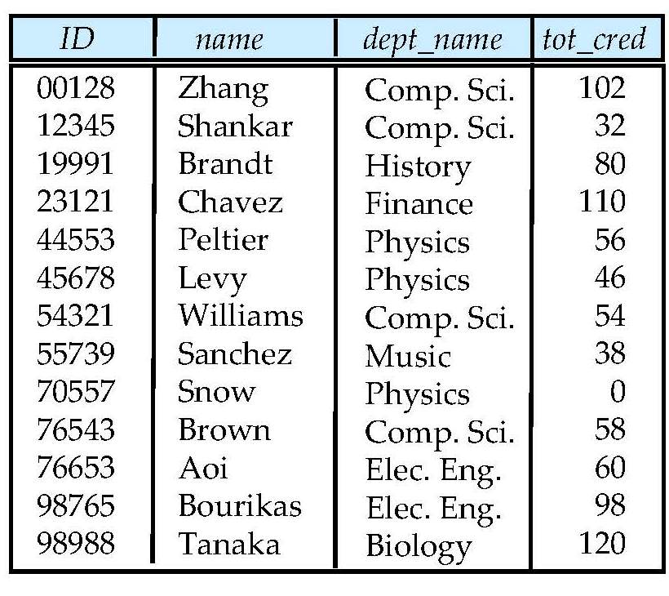
Student Relation

Slide 60
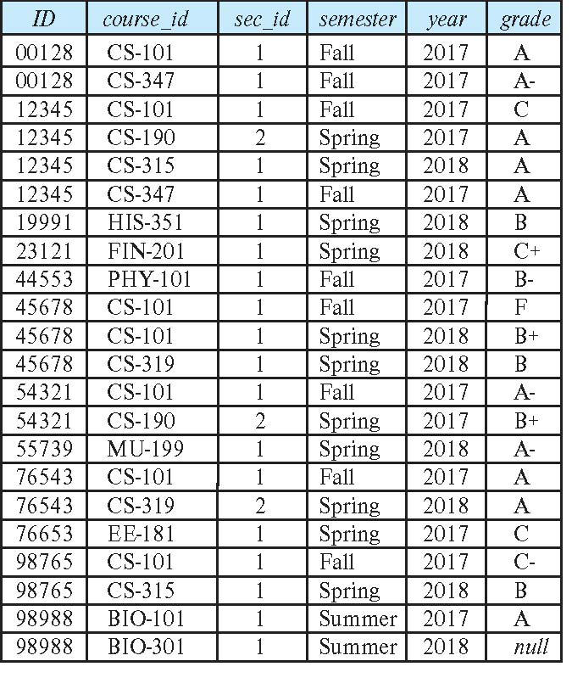
Takes Relation

Slide 61
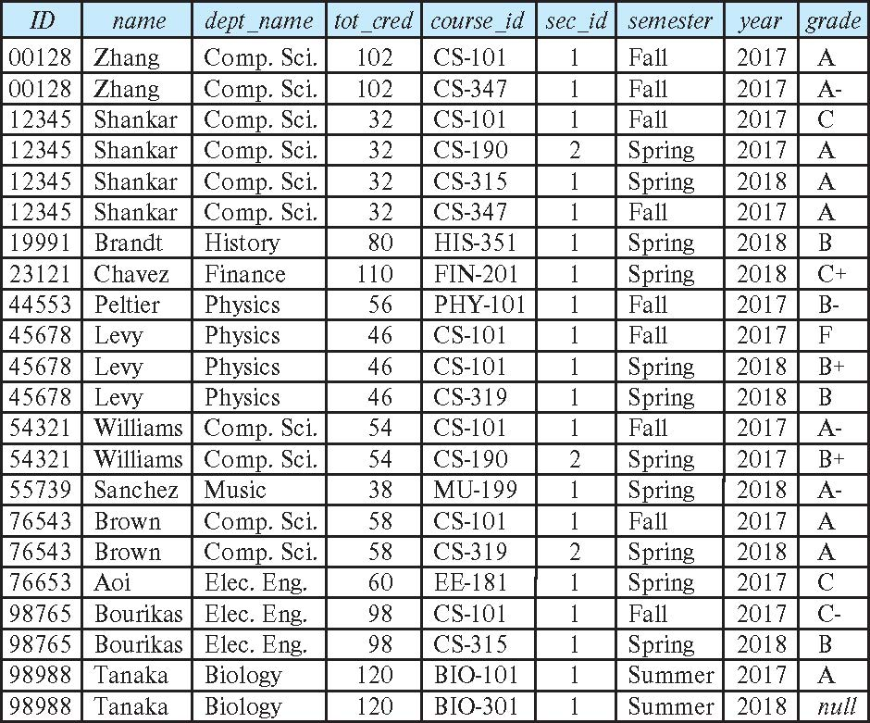
student natural join takes

Slide 62
Dangerous in Natural Join
Beware of unrelated attributes with same name which get equated incorrectly
Example -- List the names of students instructors along with the titles of courses that they have taken
Correct version
select name, title from student natural join takes, course where takes.course_id = course.course_id;
Incorrect version
select name, title from student natural join takes natural join course;
This query omits all (student name, course title) pairs where the student takes a course in a department other than the student's own department.
The correct version (above), correctly outputs such pairs.

Slide 63
Natural Join with Using Clause
To avoid the danger of equating attributes erroneously, we can use the “using” construct that allows us to specify exactly which columns should be equated.
Query example
select name, title from (student natural join takes) join course using (course_id)

Slide 64
Join Condition
The on condition allows a general predicate over the relations being joined
This predicate is written like a where clause predicate except for the use of the keyword on
Query example
select * from student join takes on student_ID = takes_ID
The on condition above specifies that a tuple from student matches a tuple from takes if their ID values are equal.
Equivalent to:
select * from student , takes where student_ID = takes_ID

Slide 65
Join Condition (Cont.)
The on condition allows a general predicate over the relations being joined.
This predicate is written like a where clause predicate except for the use of the keyword on.
Query example
select * from student join takes on student_ID = takes_ID
The on condition above specifies that a tuple from student matches a tuple from takes if their ID values are equal.
Equivalent to:
select * from student , takes where student_ID = takes_ID

Slide 66
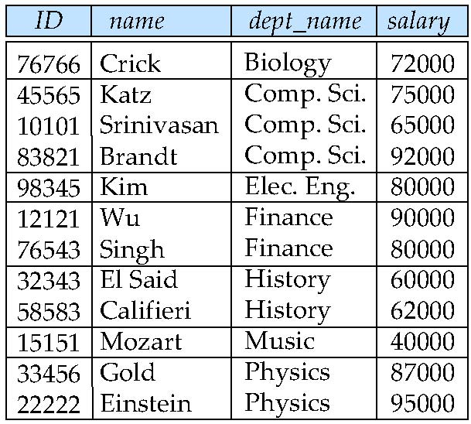
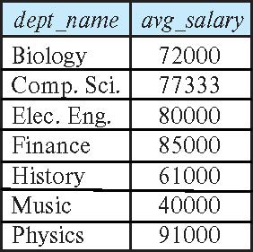
Aggregate Functions – Group By
Find the average salary of instructors in each department
select dept_name, avg (salary) as avg_salary from instructor group by dept_name;

Slide 67
Aggregation (Cont.)
Attributes in select clause outside of aggregate functions must appear in group by list
/* erroneous query */ select dept_name, ID, avg (salary) from instructor group by dept_name;

Slide 68
Aggregate Functions – Having Clause
Find the names and average salaries of all departments whose average salary is greater than 42000
Note: predicates in the having clause are applied after the formation of groups whereas predicates in the where clause are applied before forming groups
select dept_name, avg (salary) as avg_salary
from instructor
group by dept_name
having avg (salary) > 42000;

Slide 69
Nested Subqueries
SQL provides a mechanism for the nesting of subqueries. A subquery is a select-from-where expression that is nested within another query.
The nesting can be done in the following SQL query select A₁, A₂, ..., A_{n} from r₁, r₂, ..., r_{m} where P
as follows:
From clause: r_{i} can be replaced by any valid subquery
Where clause: P can be replaced with an expression of the form:
B <operation> (subquery)
B is an attribute and <operation> to be defined later.
Select clause:
A_{i} can be replaced be a subquery that generates a single value.

Slide 70
Entity-Relationship Model, SQL Worked Example
70 | W4111_02_F20: Introduction to Databases -- Lecture 3

Slide 71
Outline
Overview of the Design Process
The Entity-Relationship Model
Complex Attributes
Mapping Cardinalities
Primary Key
Removing Redundant Attributes in Entity Sets
Reducing ER Diagrams to Relational Schemas
Extended E-R Features
Entity-Relationship Design Issues
Alternative Notations for Modeling Data
Other Aspects of Database Design
We will:
Cover concepts, as much as we can now.
Show how to realize in SQL.

Slide 72
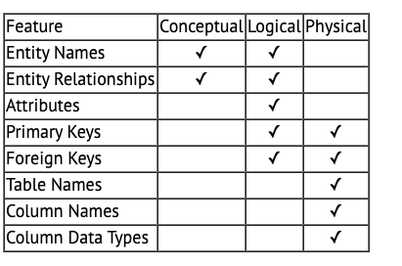
Logical – Physical – Conceptual (Reminder)
https://ehikioya.com/conceptual-logical-physical-database-modeling/
https://www.1keydata.com/datawarehousing/data-modeling-levels.html
It is easy to get carried away with modeling. You can spend all your time modeling and not actually build the schema.
We will use the approaches in class.
Mostly to understand concepts and patterns.
https://www.1keydata.com/datawarehousing/data-modeling-levels.html
72 | W4111_02_S20: Introduction to Databases -- Lecture 3,4

Slide 73
Design Alternatives
In designing a database schema, we must ensure that we avoid two major pitfalls:
Redundancy: a bad design may result in repeat information.
Redundant representation of information may lead to data inconsistency among the various copies of information
Incompleteness: a bad design may make certain aspects of the enterprise difficult or impossible to model.
Avoiding bad designs is not enough. There may be a large number of good designs from which we must choose.
Emphasis Added
Notes:
73

Slide 74
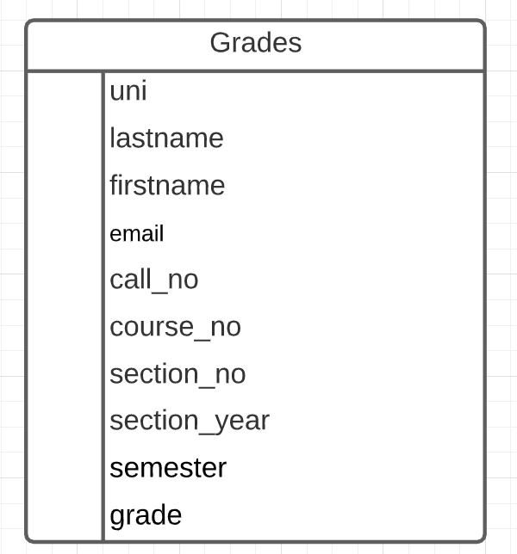
What is an Example?
Consider the Grades table/relation:
Uni identifies student.
lastname, firstname, email have obvious meaning.
call_no, course_no, section_no, semester, section_year, grade have the obvious meanings relative to Columbia course info.
Let’s focus on redundant information problems:
Inside the table:
(uni, lastname, firstname, email)
(call_no, course_no, section_no, section_year, semester)
Between tables: Presumable there are other tables with information on
Course descriptions and sections.
Course enrollments.
Additional student information.
This is easier if we make some data and show how we can “break it.”
74 | W4111_02_S20: Introduction to Databases -- Lecture 3,4

